Slide 1
Online Learning Platform​
TEAM
Sai Charan Reddy Suravarapu​ - (Project Manager)
Srikanth Pamulapati – (Technical Lead)
Priyanka Bolem – (System Architect​)
Bharath Simha Reddy Kothapeta​ - (Quality Analyst)
Viplav Billa​ - (Business Analyst)

Slide 2

Outline
Introduction.
Problem Statement.
Use Cases.
Functional Requirements.
Non-Functional Requirements.
Architecture Plans.
Data Management Plan.
Prototype demos
Accomplishments.
Spring 2025 Plan

Slide 3

Introduction
The Online Learning Platform is designed to empower educators and learners by offering a comprehensive suite of tools for course creation, management, and tracking.
With features like customizable quizzes, automated grading, and certificates, the platform enhances the learning experience.
It supports multi-language content, low-latency video streaming, and offline access, ensuring a seamless experience for users across different devices.
Built with scalability in mind, it caters to both individual users and large institutions, adapting to varying traffic demands.

Slide 4

Problem Statement
Users of the online learning platform struggle to manage their learning experience due to a lack of organization and delayed feedback, making it difficult to efficiently track progress and access course materials.

Slide 5

USE CASES
1. Course Creation and Management
2. Browsing Course Catalog
3. Enrolling in a Course
4. Accessing Course Materials
5. Taking Quizzes
6. Tracking Progress
7. Receiving a Certificate
8. Managing User Roles
9. Using the RESTful API
Check Out...!!!

Slide 6
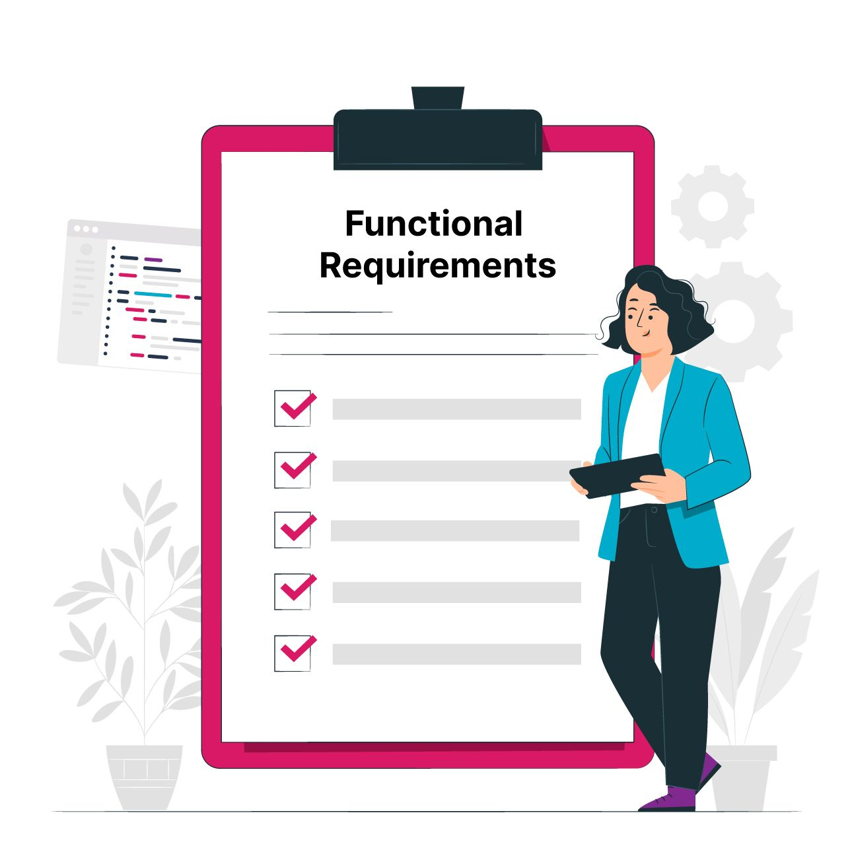
Functional Requirements
Course Creation
Course Management
Video Streaming
Downloadable Course Materials
Quizzes
Manual Grading
Certificate Generation and Issuance
Course Catalog
Advanced Search
Progress Tracking
Role-Based Access Control

Slide 7
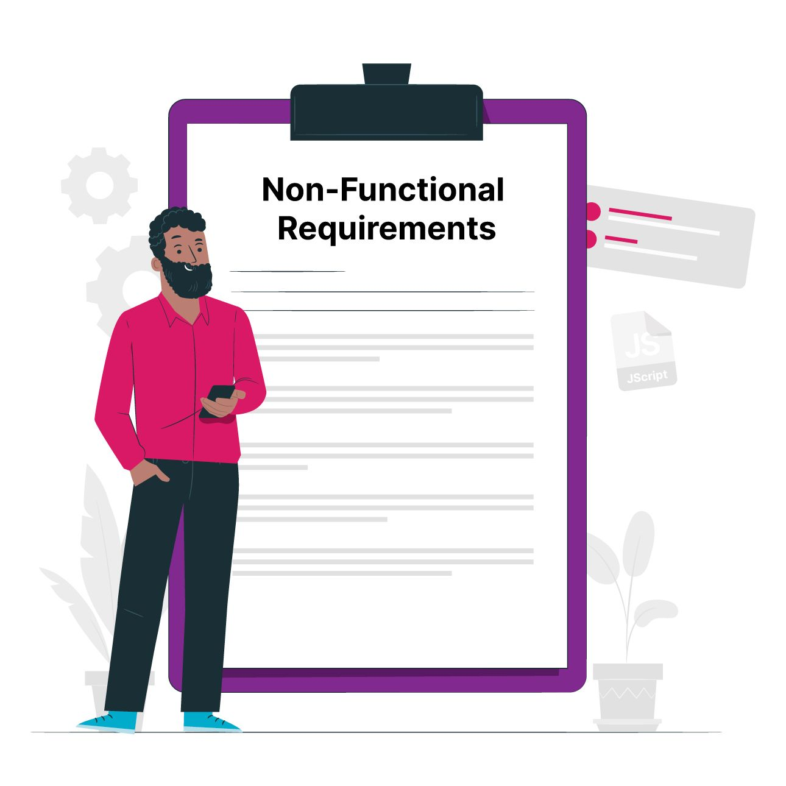
Non-Functional
Requirements
Performance
Scalable Infrastructure
Multi-Language Support
Secure and Efficient Video Streaming
User Experience
Data Security
Content Integrity
Compliance
System Reliability
Availability

Slide 8
Architecture Plans
Presentation Layer:
Handles user interactions and display contents.
Application Layer:
Contains business logic and APIs for communication between the frontend the database.
Data Layer :
Manages persistent data storage and retrieval.
Infrastructure Layer:
Provides the underlying support for hosting, scalability, and performance.

Slide 9
Hosting Strategies & Requirements
Hosting Platform : Render, Low-cost VPS
Deployment Requirements :The backend application, database server, and real-time communication modules will be deployed together

Slide 10
Design Patterns
MVC (Model View Controller)
Model : Represents data and business logic
View : Displays data to the user and handling the visual elements of the application.
Controller : Manages the input & updates the model and views.
Factory pattern : Create the creates without specifying the class of the object.
Strategy pattern : Defines a family of algorithms or behaviors and make them interchangeable.
Observer pattern : Allows objects to listen for events in other objects.

Slide 11
Platforms and Technologies
Front-End Technologies :
HTML
JavaScript
Bootstrap
Back-End Technologies :
Java (Spring Boot)
Database Management :
MySQL
Cloud Services :
React
CSS
AWS for hosting and storage.
AWS RDS for database hosting.

Slide 12
Third-Party Libraries to Provide Functionality
Front-End Libraries:
Material-UI
Chart.js for analytics
Back-End Tools:
Spring security for authentication
API Management:
Postman
Swagger
Payment Gateways:
Stripe
PayPal SDKs

Slide 13
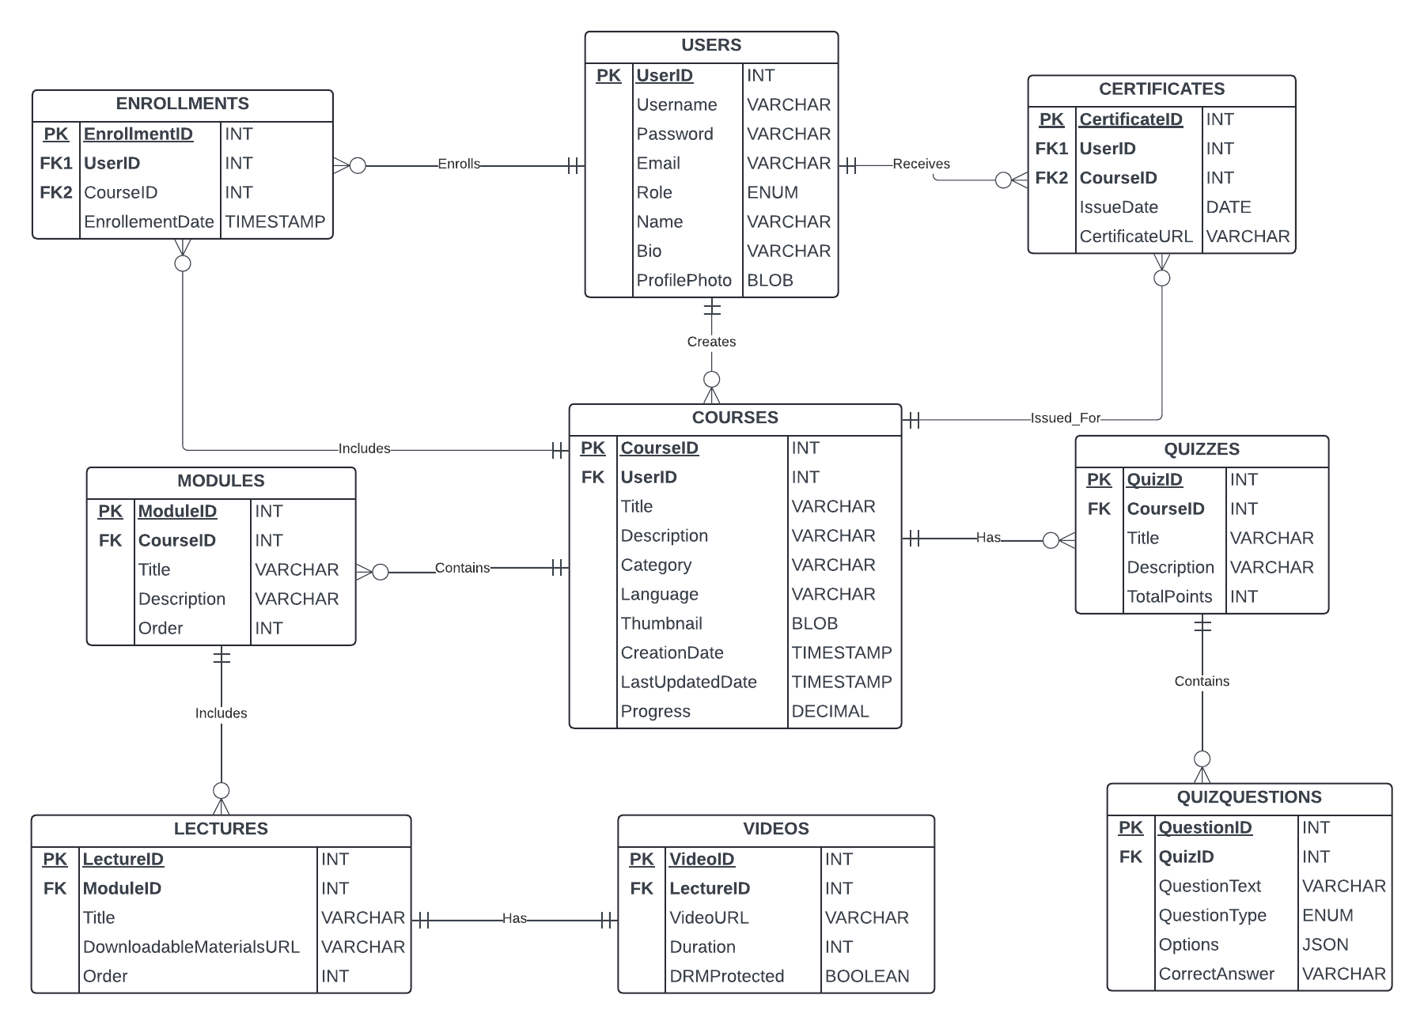
Data
Manage-ment
Plan

Slide 14
Database Management Plan
Access Restriction:
Implement role-based access control, ensuring instructors can manage their own courses, students can access course content and administrators has full access to the platform.
Data Encryption:
Sensitive data such as user passwords will be hashed using bcrypt with salts.
Encryption of stored video files using DRM to prevent unauthorized access.
Database Security:
Utilize prepared statements and parameterized queries to prevent SQL injection.
Backup and Recovery:
Regular automated backups of all data.
Secure storage of backups with encryption.

Slide 15
Prototype demos
User Login and Registration Interface
Course Creation Dashboard
Course Catalog Page
Course Detail View
Video Player Interface
Quiz Creation and Grading Interface
Progress Tracking Dashboard
Certificate Generation Feature
Admin Role Management Interface
RESTful API Documentation

Slide 16
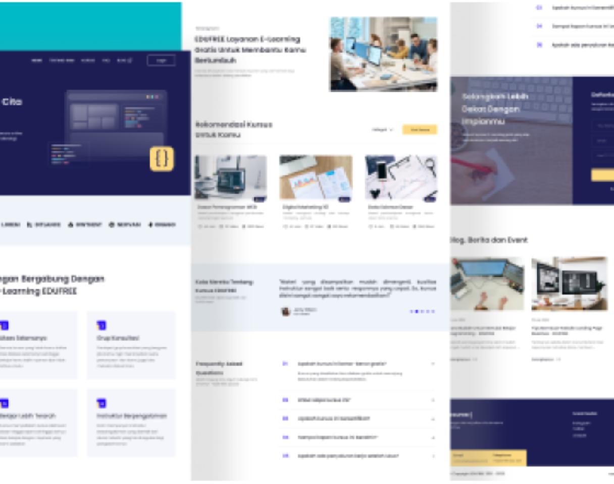
Planned GUI

Slide 17
Accomplishments
Problem Statements and Proposed Solutions.
Functional Requirements and Non-Functional Requirements.
Use Cases.
Data Management Plan.
Proposed Prototypes for login interface, course creation dashboard, course catalog, course detail view, video player interface, quiz creation and grading, progress tracking.
Seed Data.

Slide 18
SPRING 2025 Plan
Development Phase
UI/UX Refinement
API Integration
Security Implementation
Quality Assurance & Testing
User Training & Documentation
Performance Optimization
Maintenance and Support

Slide 19
References
Liu, Z.Y., Lomovtseva, N., & Korobeynikova, E. (2020). Online learning platforms: Reconstructing modern higher education. International Journal of Emerging Technologies in Learning (iJET), 15(13), 4–21. Kassel, Germany: International Journal of Emerging Technology in Learning. Retrieved December 1, 2024, from https://www.learntechlib.org/p/217605/
Liu, B. (2022). Design of English online learning platform based on deep learning technology. 2022 World Automation Congress (WAC), 277–281. https://doi.org/10.23919/WAC55640.2022.9934238
Aczel, J., Cross, S., Meiszner, A., Hardy, P., McAndrew, P., & Clow, D. (2011). Some issues affecting the sustainability of open learning courses. EDEN 2011 Annual Conference, Dublin, Ireland, 19–22 June 2011.

Slide 20
Thank You…!!!

